Slide 1
GrowSmarter – Integrated solutions for smart cities/testing innovative models in Oslo
Smart Energy Network
Cato Kjølstad / Head of public affairs Norway / 21. May 2019
Notes:
12.15: GrowSmarter – Integrated solutions for smart cities/testing innovative models in Oslo
Cato Kjølstad, Head of public affairs Norway, Fortum
GrowSmarter is an EU funded project that brings cities and industry together to demonstrate 12 smart city solutions. Its goal is to provide valuable and practical insights on energy, infrastructure and transport. Fortum is taking an important role as an innovative technology-based energy supplier in many cities in Nordic countries.
Oslo was elected EUs green capital 2019. As a part of the green capital Fortum has decided to support three action areas being modeled at Furuset district in Oslo: Micro Energy system, Integrated infrastructure and Sustainable Urban Mobility. Furuset is also one of eight pilot projects in the national FME (Centres for environmental-friendly research) ZEN (zero emission neighborhood). Focus is developing smart solutions to improve end-user flexibility and security of supply by testing innovative models for efficient resource utilization and energy markets coupling (electricity and heating) as well as integration of energy storage solutions.

Slide 2
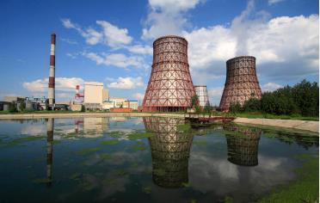
Fortum – for a cleaner world
Nordic countries
Power generation 45.4 TWh
Heat sales 5.0 TWh
Electricity customers 2.4 million
Power generation
City Solutions
Poland
Power generation 0.5 TWh
Heat sales 3.7 TWh
Consumer solutions
Russia
Russia (PAO Fortum)
Power generation 26.3 TWh
Heat sales 19.8 TWh
Solar and Wind Development
Technology and New Ventures
Baltic countries
Power generation 0.7 TWh
Heat sales 1.4 TWh

Slide 3
Fortum – Business in Norway
City Solutions
District heating and cooling
Waste incineration
CCS-project
Recycling solutions
Smart city solutions
Consumer solutions
Brands (consumer solutions)
Fortum (including charge and drive)
Hafslund Strøm
Norges Energi
Hallingkraft
Solar and Wind power
3 installations in Northern Norway together with Nordkraft

Slide 4
Fortum Oslo Varme – City solution
Energy sources 2018:
WASTE HEAT 60,8 %
1010
apartment building
ELECTRISITY 24 %
1168
comercial building
HEATPUMP/
SEWER 5,6 %
3289
Domestic housing
DATACENTER (2019)
Distric heating, cruiseships
WOOD PELLET 5,8 %
BIOFUEL 2,3 %
FOSSIL OIL 0,1 %
District heating
LNG 1,4 %
ENERGY RECOVERY FROM 400.000 TONNES WASTE/ YEAR
600 km district heating network
30 mill liters hot water distributed throughout Oslo
District cooling
Production capacity
150 GWh
electricity (est. 2018)
Notes:
Est. 190 employees.
Waste heat from approx. 400,000 tonnes of waste per year.
Produces 1.7 TWh of district heating per year.
Produces about 150 GWh of electricity (est. 2017)
600 kilometers of district heating pipes.
30 million liters of water in constant circulation.
Over 5200 delivery points
Over 200,000 end customers

Slide 5
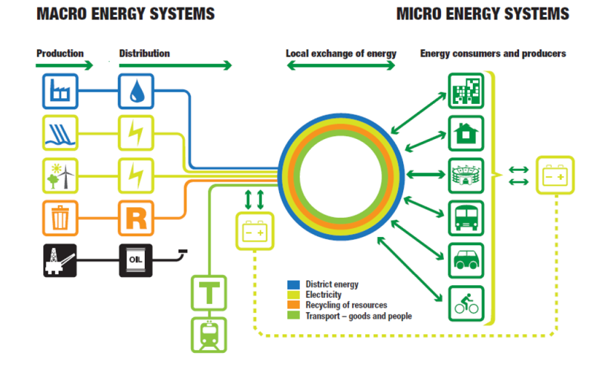
Elements of macro and micro energy system with exchange between them. Source : The cilmate and energy strategy for Oslo

Slide 6
The work packages of Furuset micro energy system

Slide 7
Furuset ̶ Seasonal storage and micro grid
Photo: FutureBuilt
Notes:
Store excess heat from the waste incineration from summer to winter. The heat will be fed in to the DH-system and will reduce the use of peak boilers.
Low temperature DH. Enables efficient utilization of the high temperature seasonal storage Low temperature building distribution system
Enables efficient utilization of the low temperature grid and the high temperature seasonal storage
The heat will be used in the local low temperature grid of Furuset and supplemented with district heating from the main grid
The seasonal storage will decrease cost of heat production as well as reducing the peak heat capacity demand of the area

Slide 8
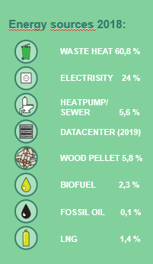
The new integrated datasenter gives av surplus heat ≈ 5 000 Oslo apartments
DigiPlex: 100% renewable energy since 2004
One of the greenest & most energy efficient
District heating a great tool for moving energy From energy surplus -> energy demand.
Excess heat no longer to be released into the atmosphere
Excess heat sent back to the consumer as district heating.
Notes:
DigiPlex has been running 100% renewable energy since 2004, and the company's data center is some of the world's greenest and most energy efficient.
It is a great tool for moving energy from someone who has an energy surplus to someone who demands energy. We are very pleased to be able to transport heat from the data centers.
This type of third-party supply in the district heating network is the best for the environment and the city's population, he says.
- In this way we strengthen Oslo's circuit-based energy system
Surplus heat of Oslo apartments
Soon the energy created in the data center on the Wolf will warm up 5000 Oslo homes. DigiPlex has entered into an agreement with the energy company Fortum Oslo Varme for the recovery of surplus heat.
- Every time you are online, streaming a TV show or using a cloud service, a data center process starts. The process creates heat. Now, the heat will no longer be released into the atmosphere, but will be sent back to the consumer as district heating.
From the autumn of 2019, heat exchangers on the Wolf will send heated water out into Oslo's district heating network.

Slide 9
Fortum and the City of Oslo are working on the world's first wireless fast-charging infrastructure for taxis
"We will install the wireless chargers at taxi stands, such as the one at the Oslo Central Station. Taxis will be able to drive up to the charger and a wireless charging session will automatically start. This allows the taxis to charge in a place where they would anyway be waiting for new customers. The difference is that they won’t be emitting exhaust while waiting, instead they will be receiving renewable energy to charge the taxi's battery," says Annika Hoffner, Head of Fortum Charge & Drive.

Slide 10
CCS – a solution for a cleaner city
CCS – a global solution for a cleaner world

Slide 11
GrowSmarter – Integrated solutions for smart cities/testing innovative models in Oslo
Smart cities need:
Solutions which fulfill what the customer need
Innovation and smart thinking
Energy solutions; Integration and flexibility
Using the right resource for the right purpose
Using and developing technology for right purpose
Solutions for cleaner cities – for a cleaner world

Slide 12
Thank you for the attention
Cato Kjølstad / cato.kjolstad@fortum.com

