Slide 2
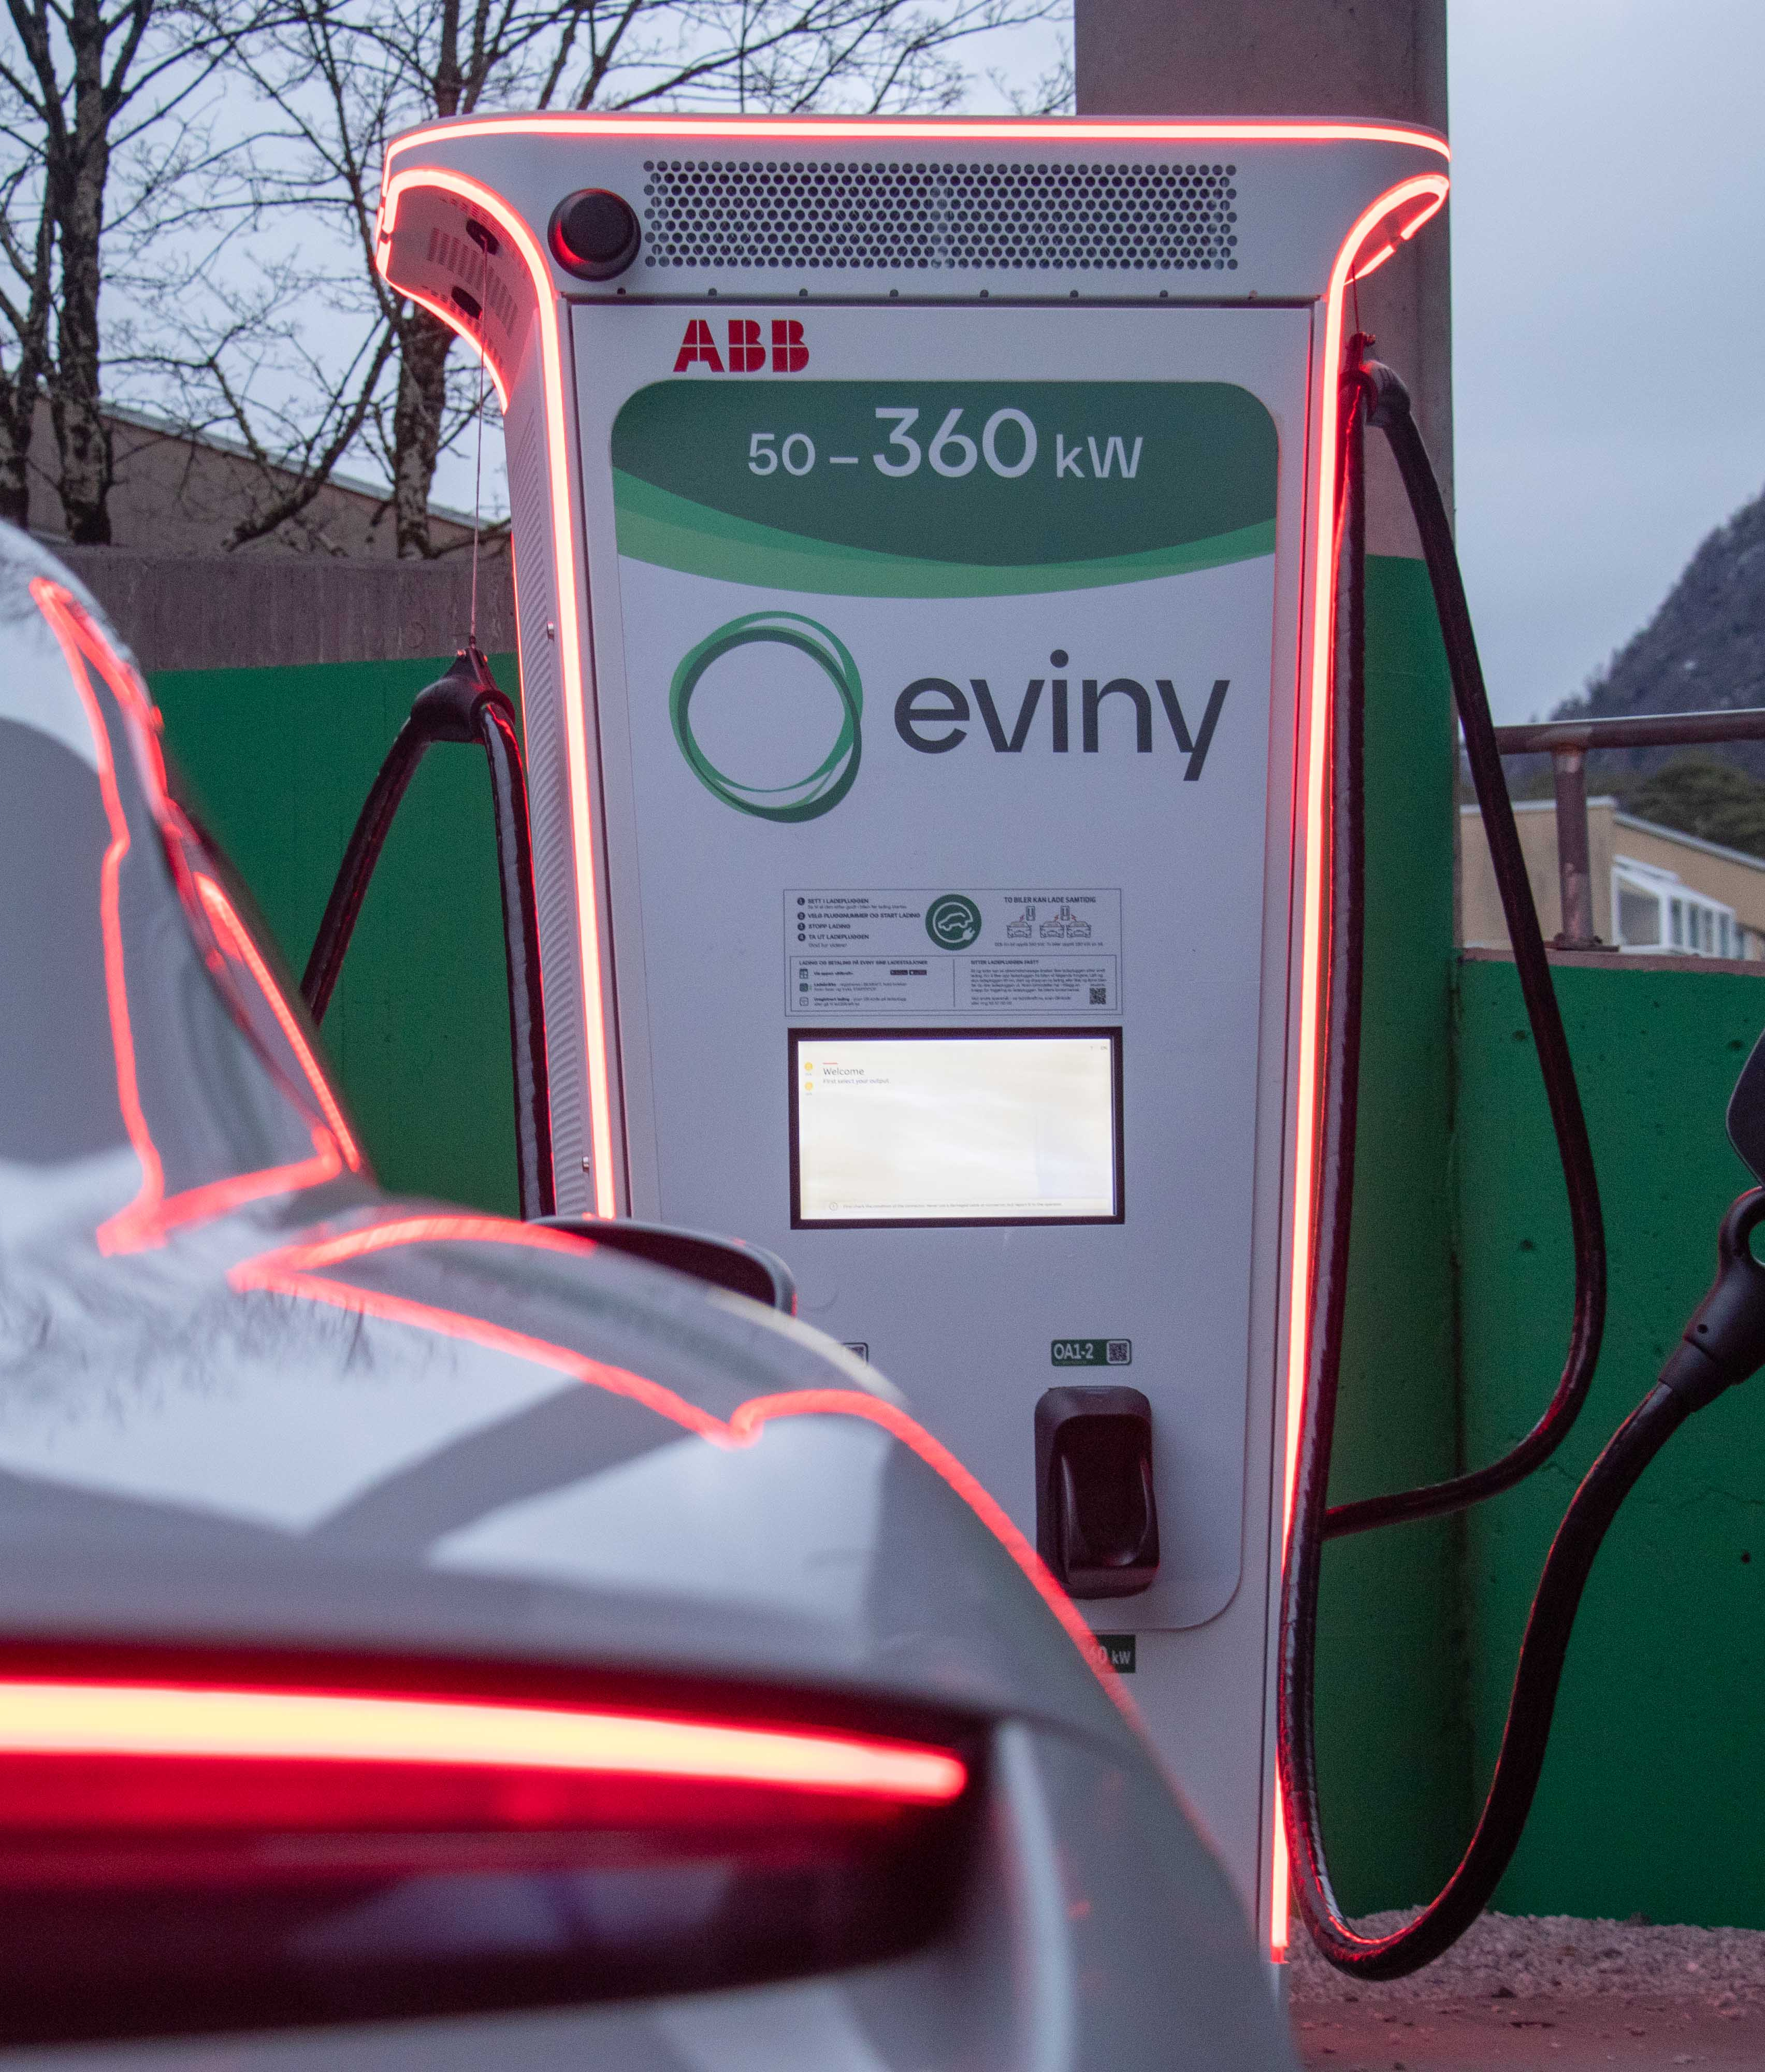
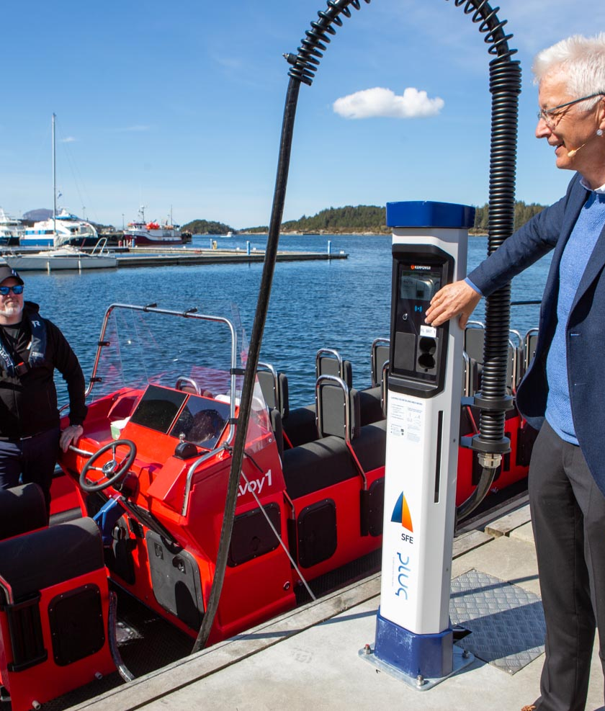
Datavitenskap og digital forretningsutvikling

Slide 3
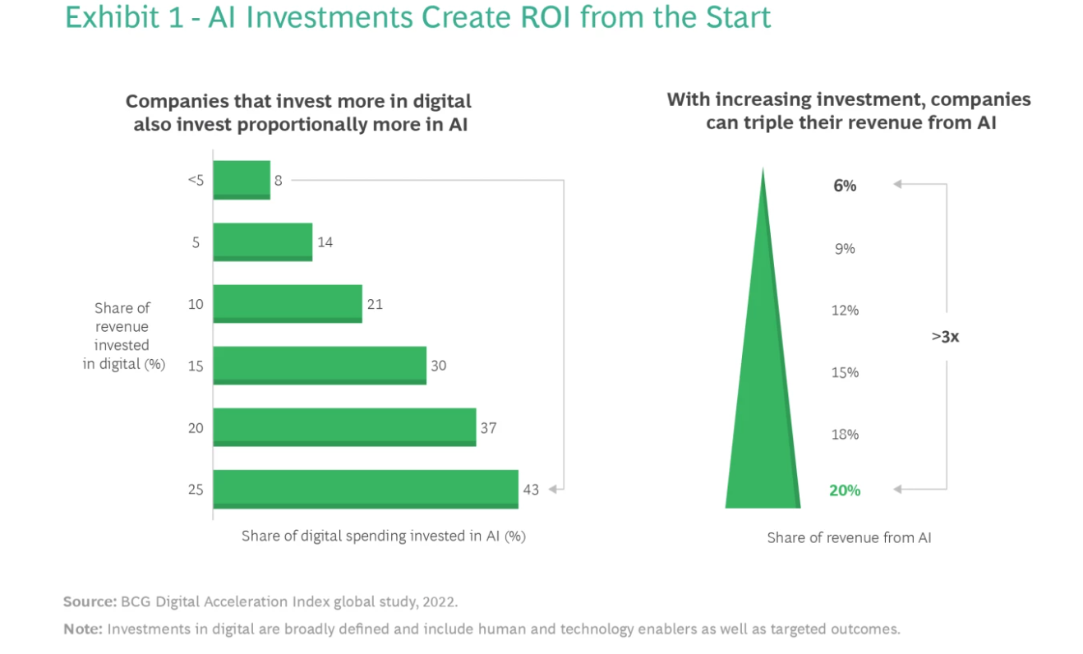

Slide 4
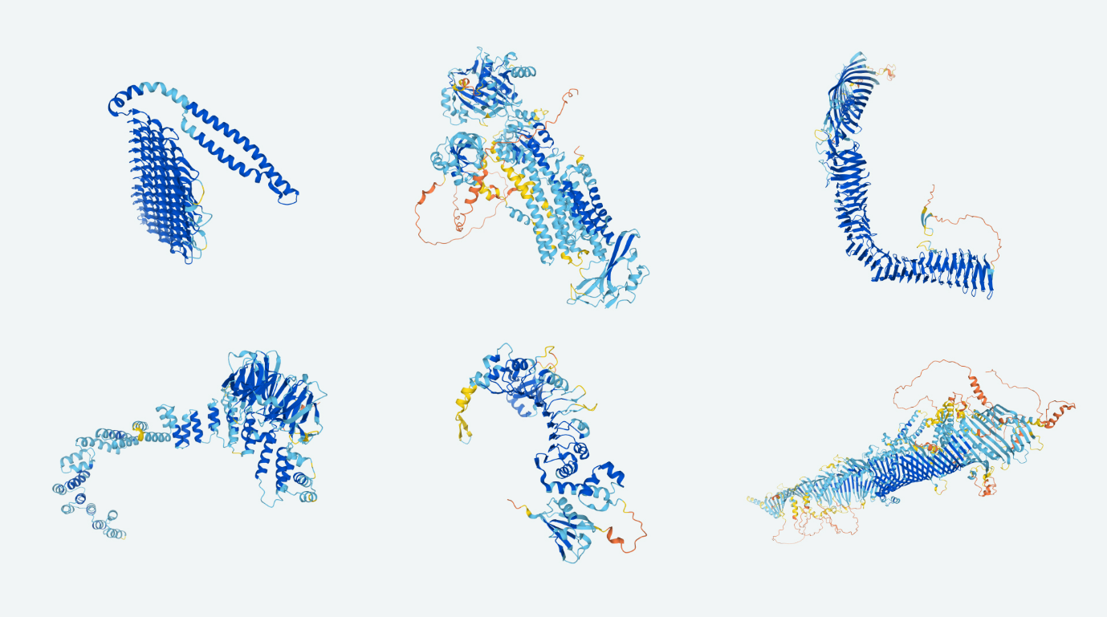
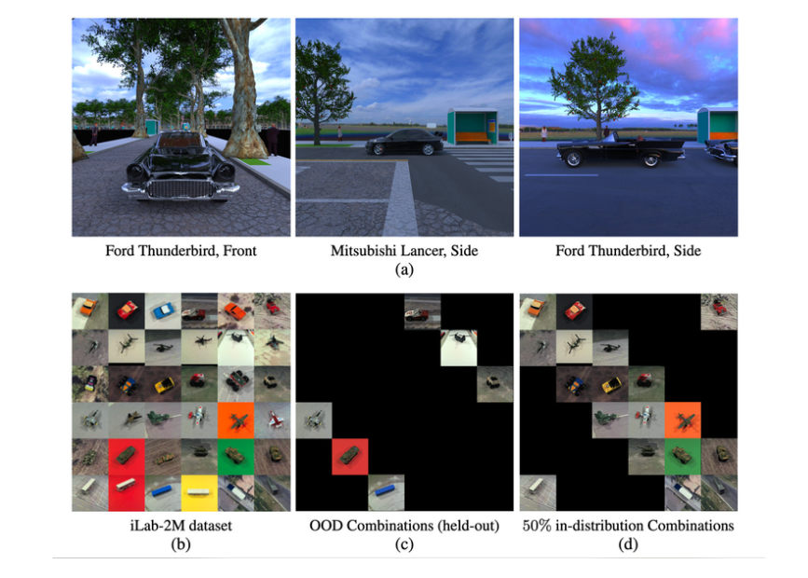
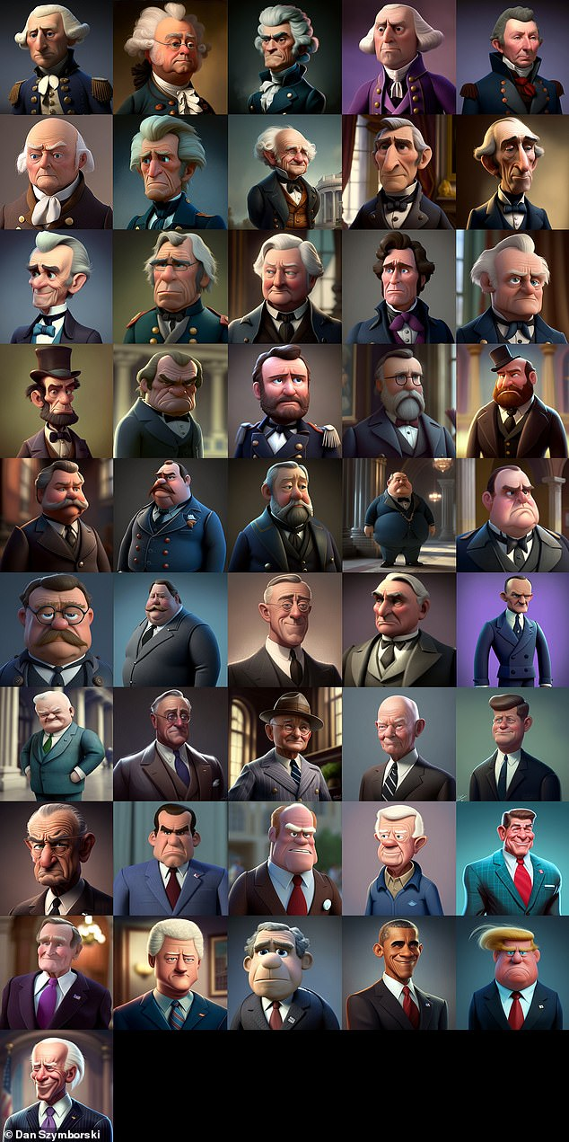
Prediction
+
Classification
=
Generation

Slide 5
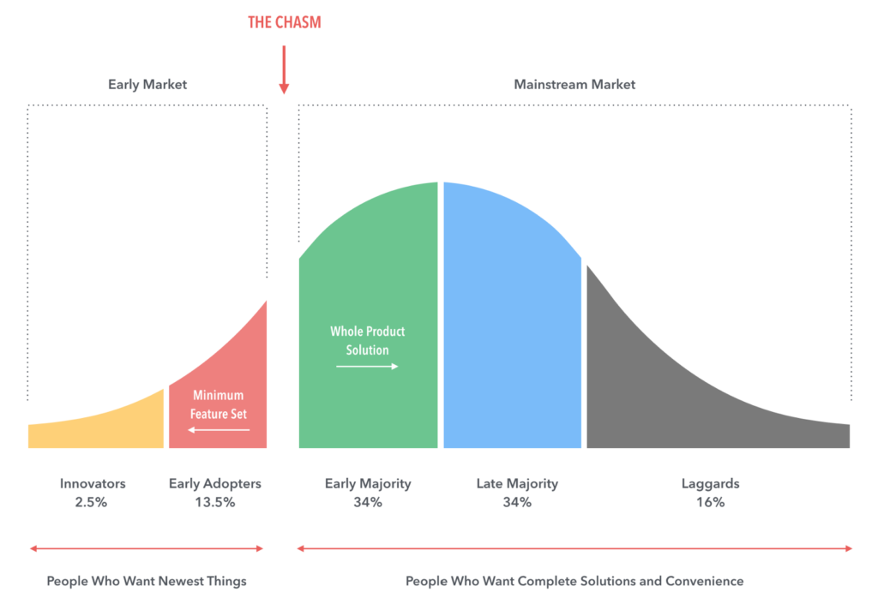
Hvorfor produktifisere

Slide 6
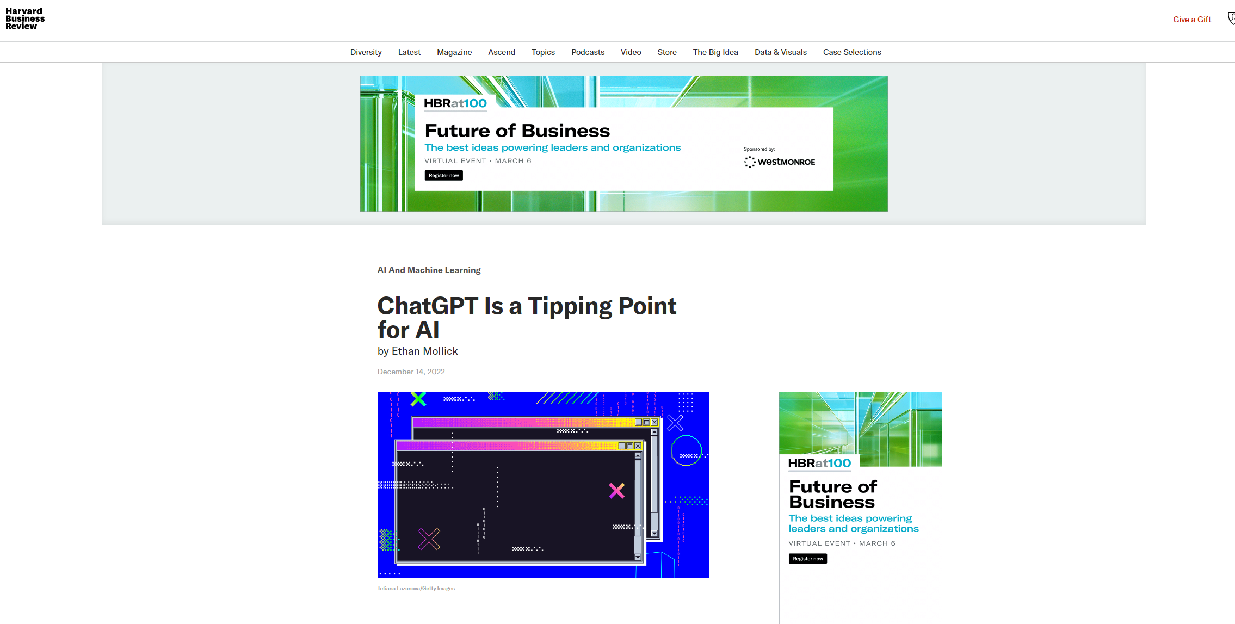

Slide 8
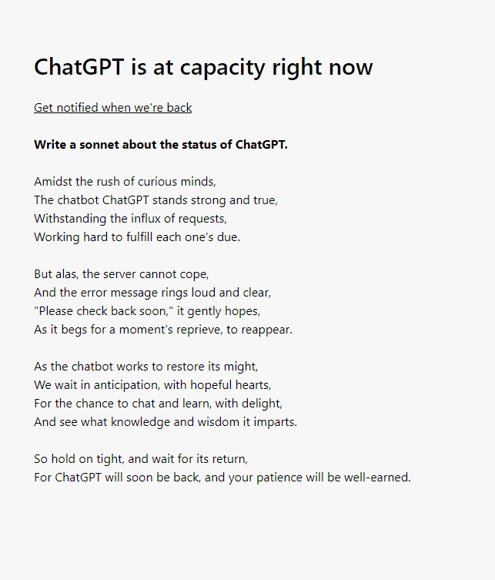

Slide 9
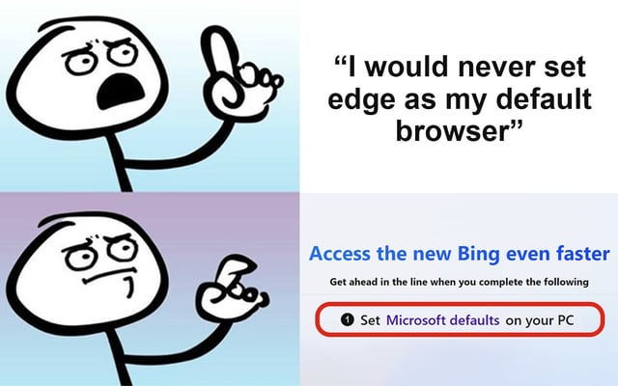

Slide 10
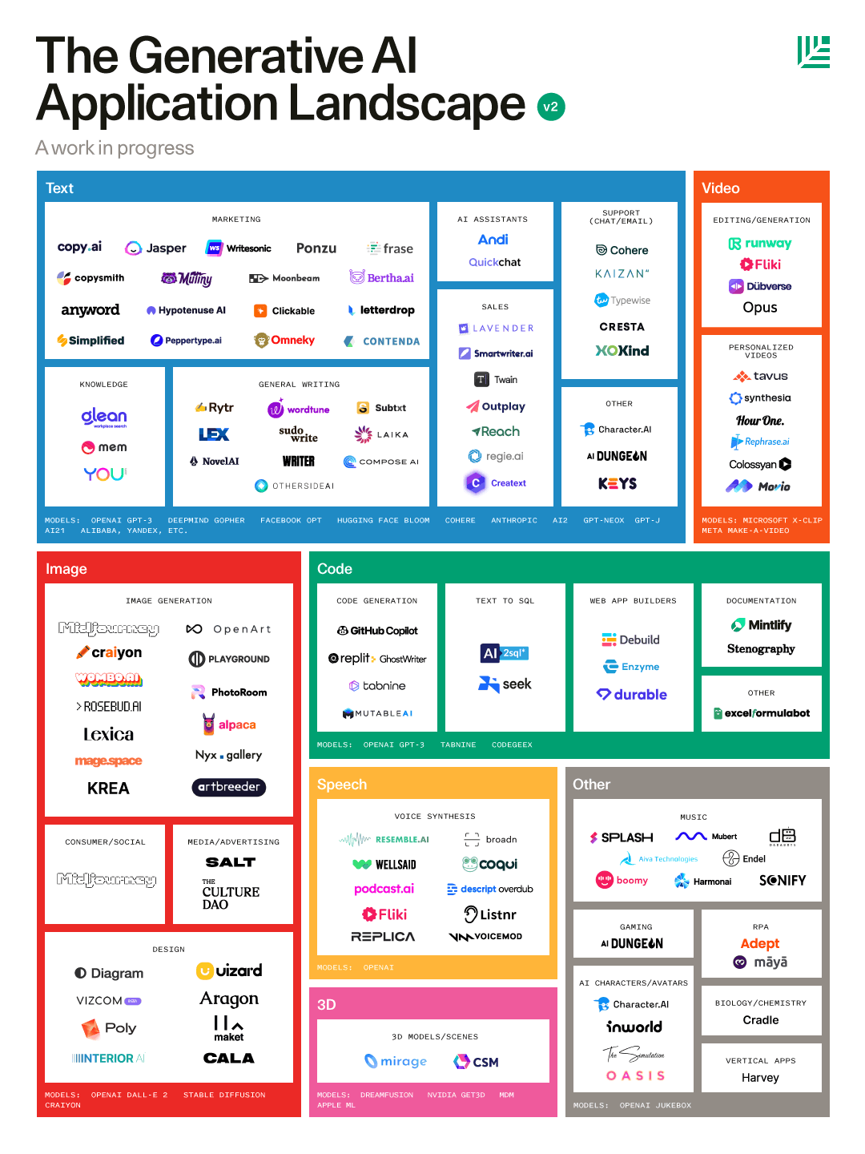
Source: Seqouia

Slide 12
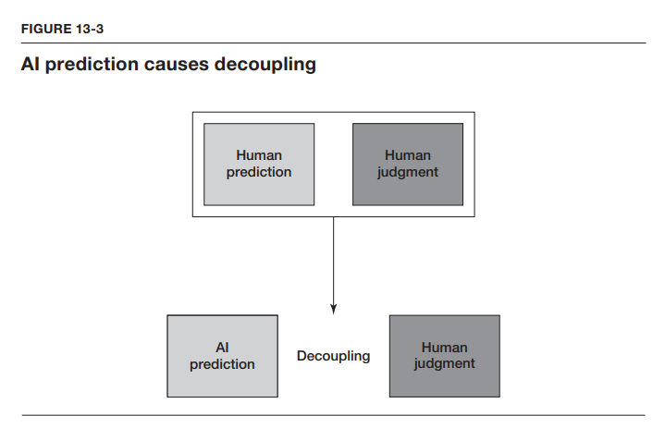
Source: Power and prediction | Ajay Agrawal, Joshua Gans, Avi Goldfarb

Slide 13
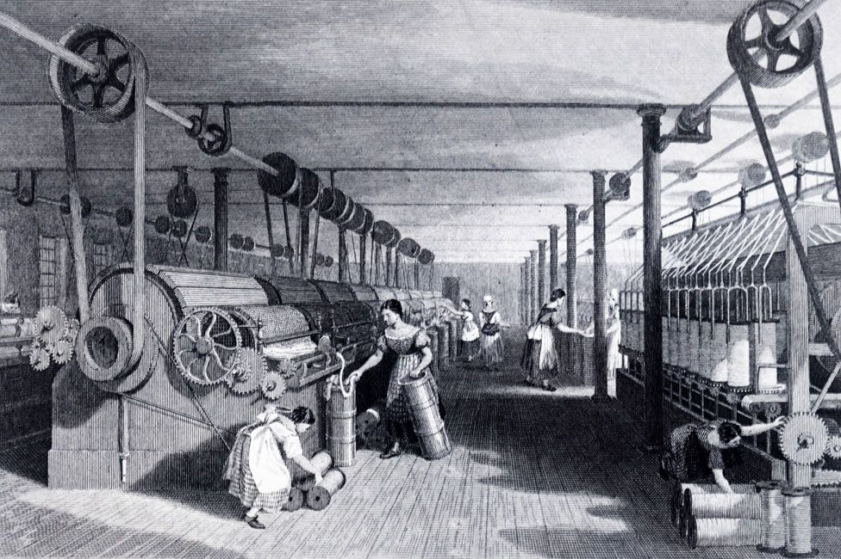
Source: Power and prediction | Ajay Agrawal, Joshua Gans, Avi Goldfarb

Slide 14
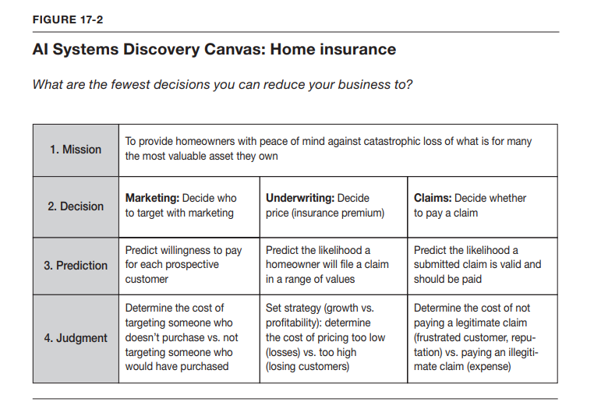
Source: Power and prediction | Ajay Agrawal, Joshua Gans, Avi Goldfarb

Slide 15
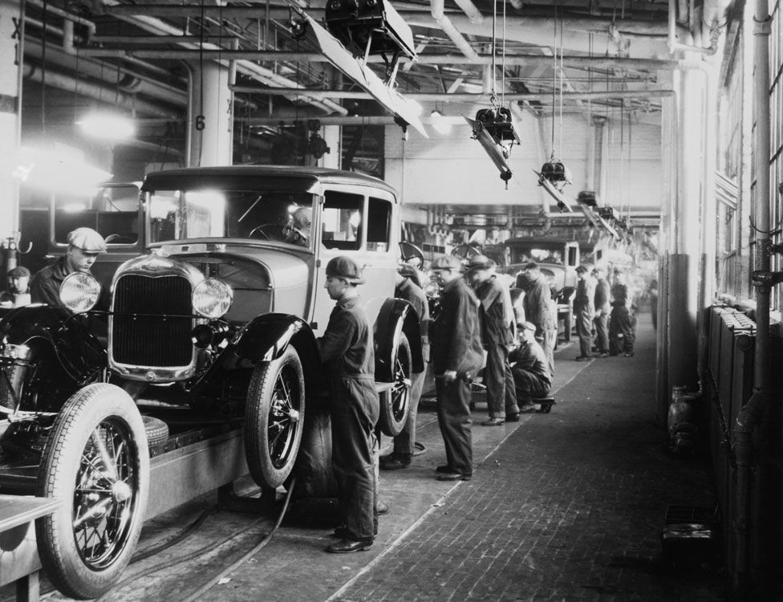
Source: Power and prediction | Ajay Agrawal, Joshua Gans, Avi Goldfarb

Slide 16
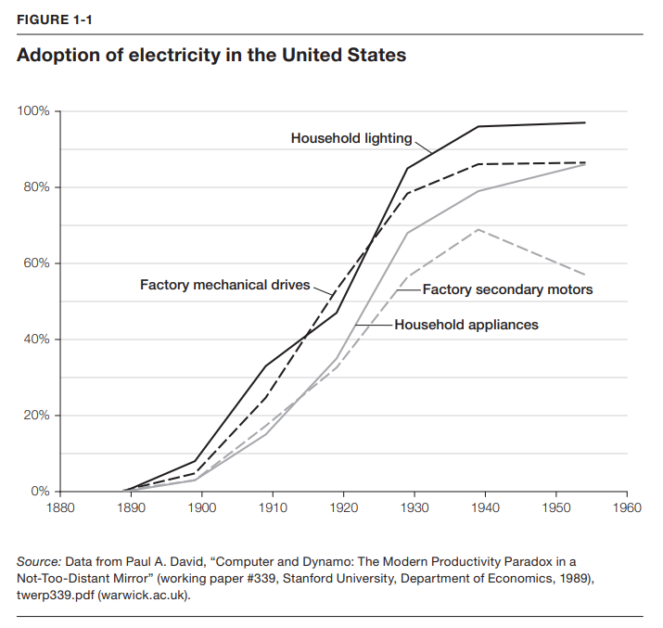
AI
Vi er omtrent her

Slide 17
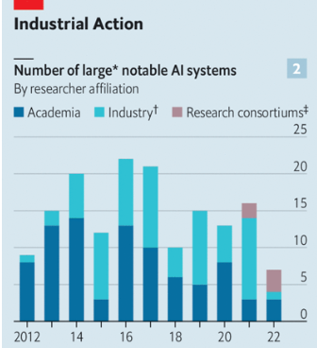
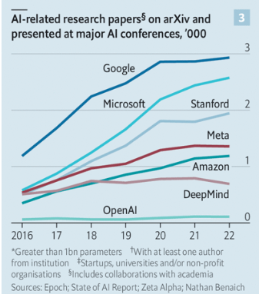
Source: The Economist

Slide 18
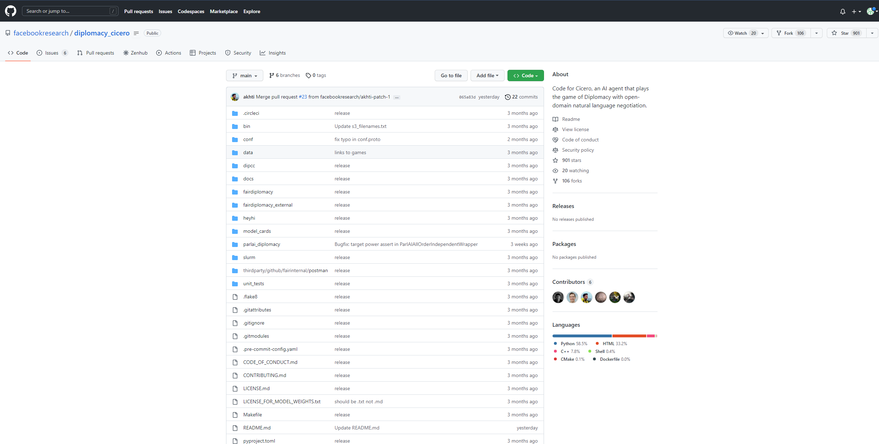

Slide 19
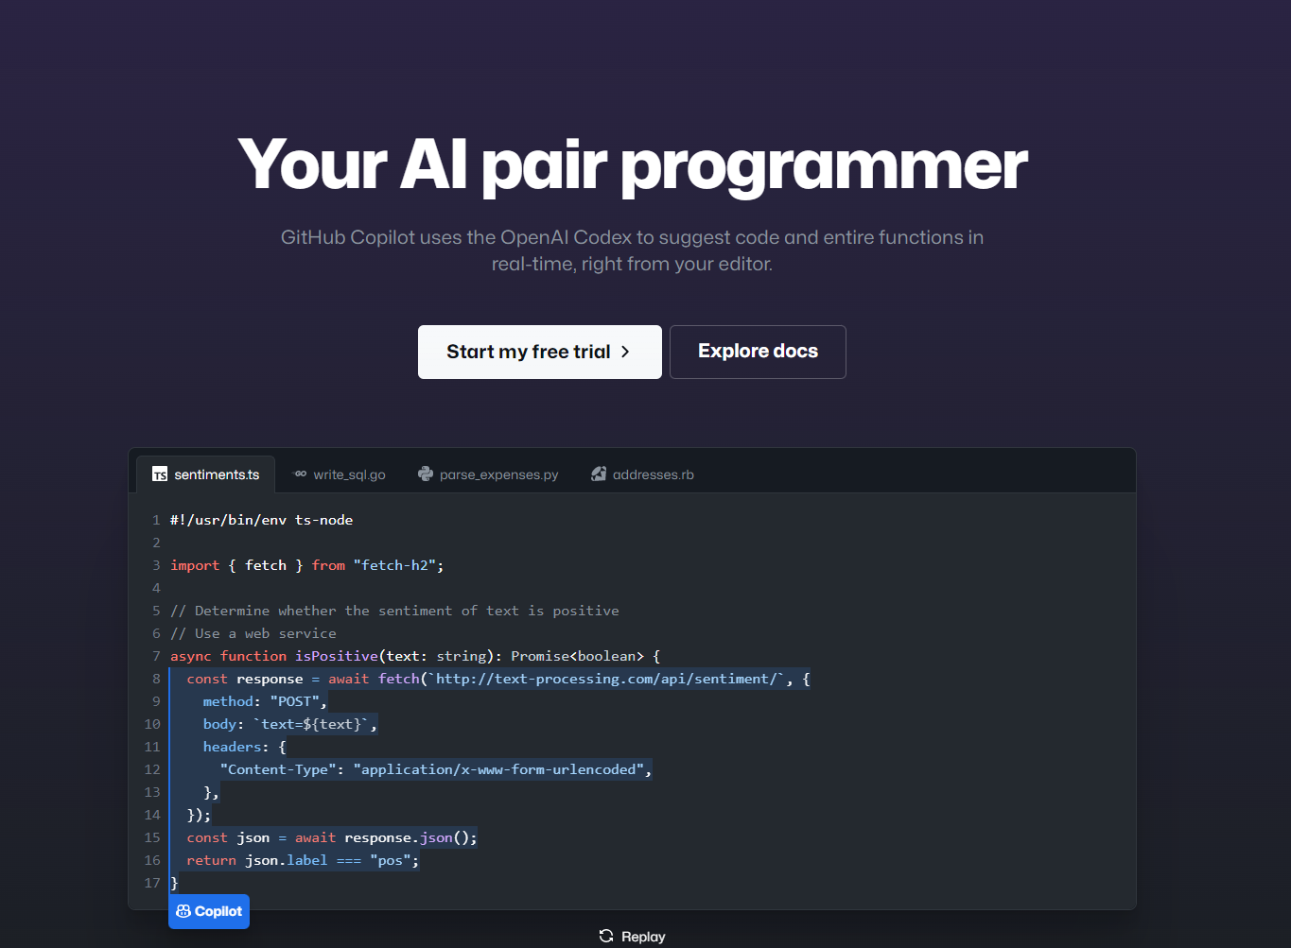

Slide 20
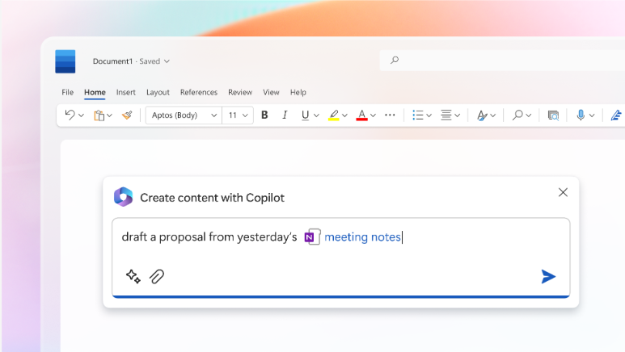

Slide 21
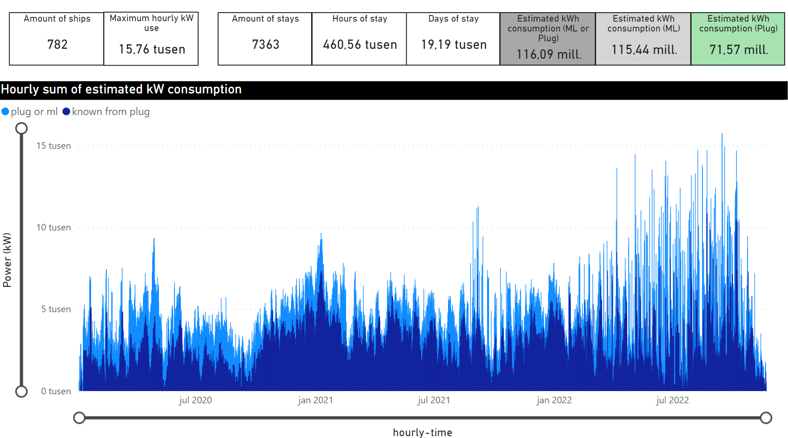

Slide 22
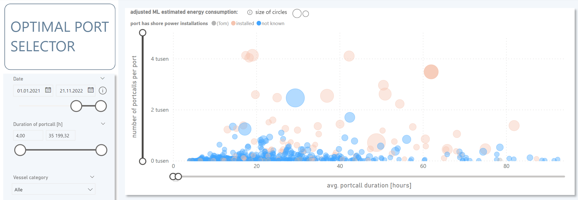

Slide 23
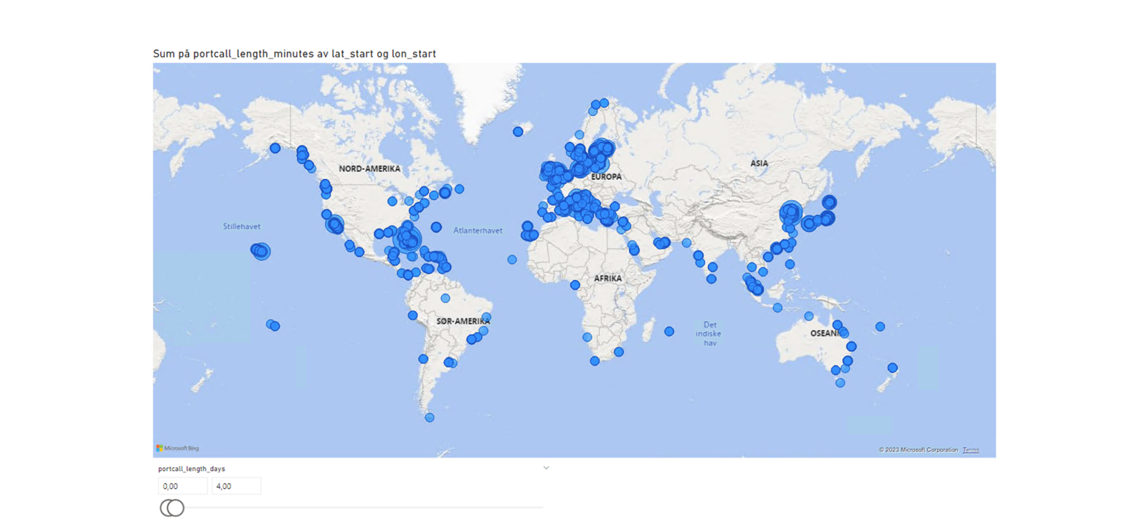

Slide 24
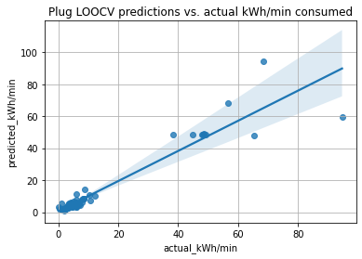

Slide 25
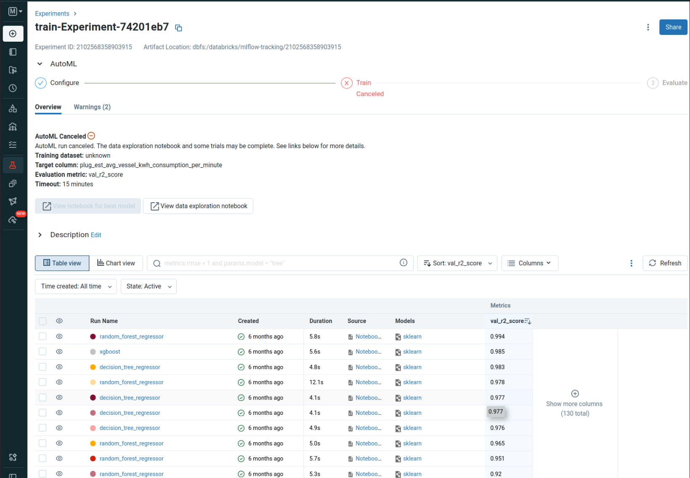

Slide 26
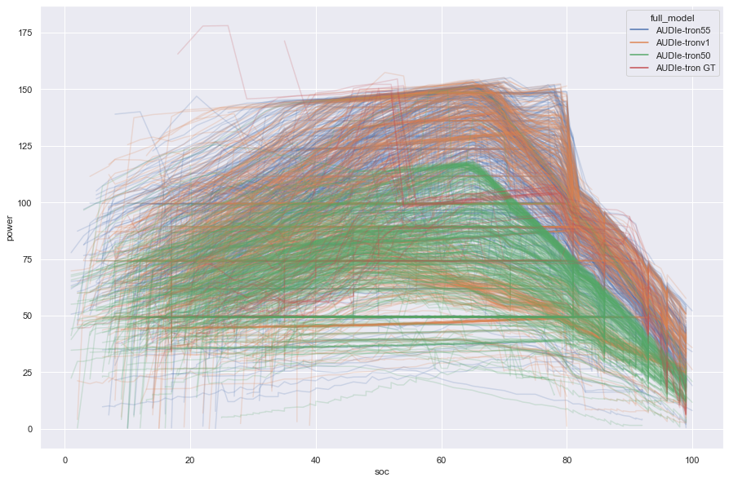

Slide 27
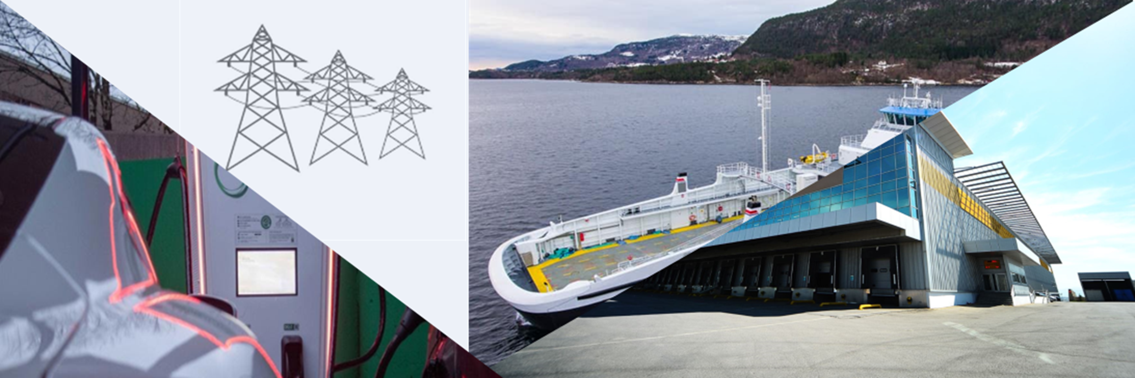
Flex-E – Effektiv fleksibilitetsaggregering for Næringsmarkedet

Slide 28
Notes:
We are putting our customers centre stage and digitalising the power grid to ensure efficient, future-oriented operations in a modern society. We maintain our power lines and plants constantly to ensure stable power supplies. We are building a future-oriented power grid in line with social developments in Western Norway.

Slide 29
Notes:
We are putting our customers centre stage and digitalising the power grid to ensure efficient, future-oriented operations in a modern society. We maintain our power lines and plants constantly to ensure stable power supplies. We are building a future-oriented power grid in line with social developments in Western Norway.

Slide 30
paint a picture of a farmer transitioning into a chef in the style of synthwave

